Slide 1
Reinforcement Learning
Introduction, Framework and Workflow
Dr. Aygul Zagidullina

Slide 2
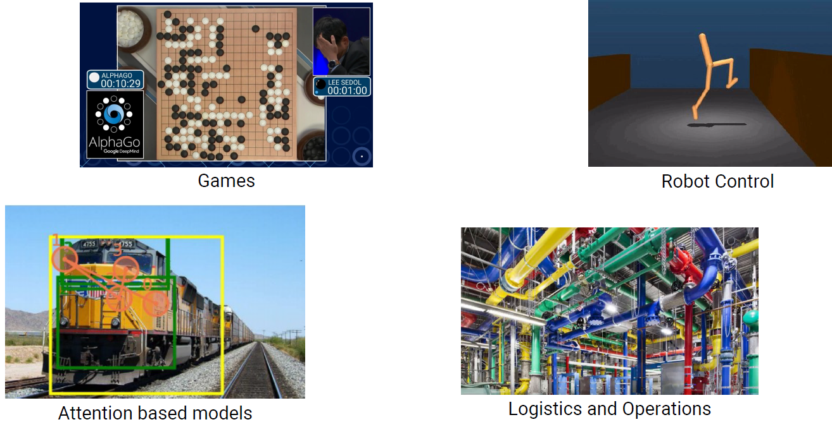
Motivation

Slide 3
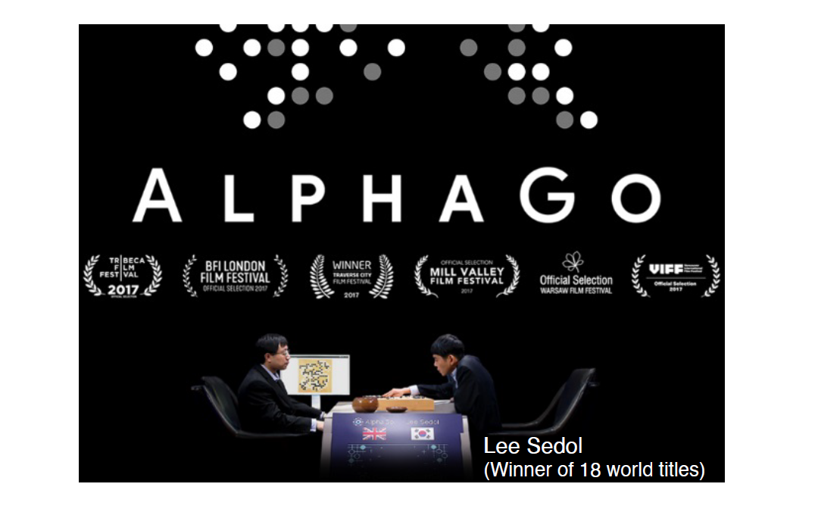
https://www.youtube.com/watch?v=WXuK6gekU1Y

Slide 4
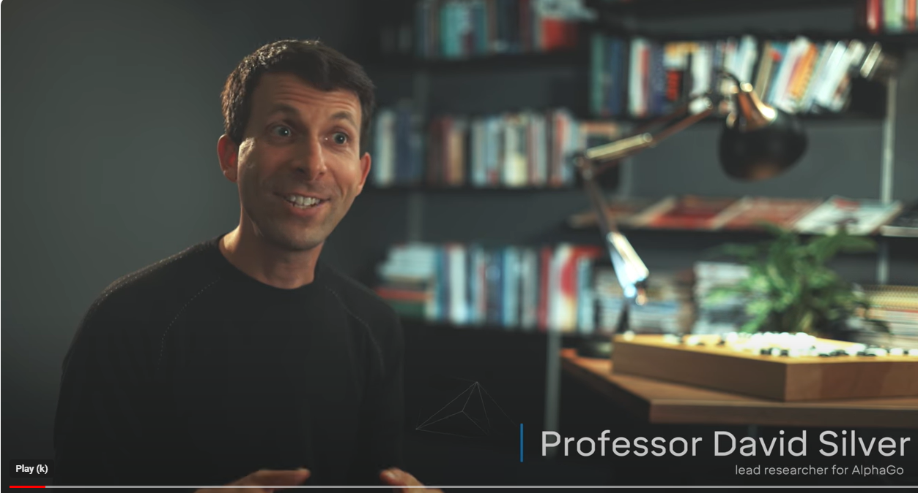
AlphaGo Zero: Discovering new knowledge
https://www.youtube.com/watch?v=WXHFqTvfFSw

Slide 5
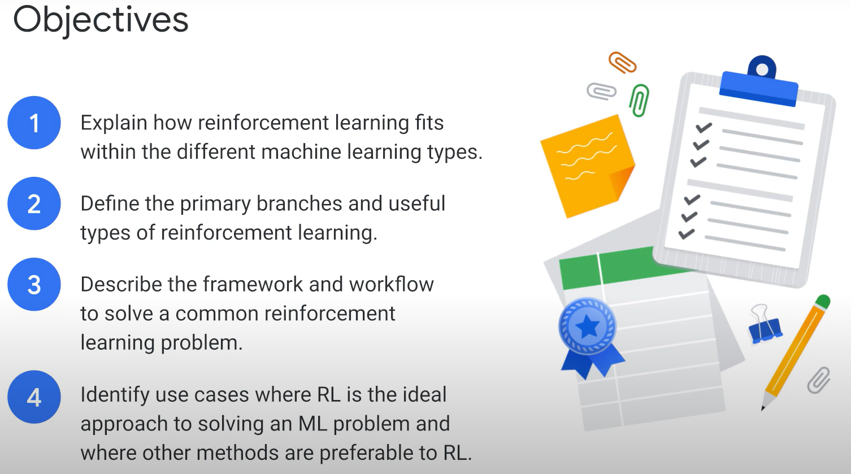
Source: cloudskillsboost.google

Slide 6
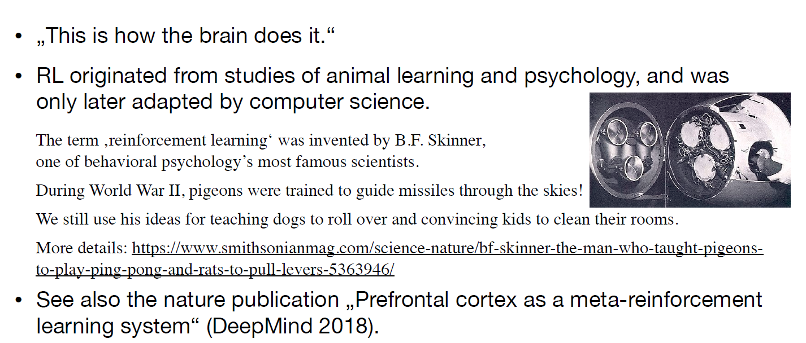
Origins of Reinforcement Learning
Source: ZHAW lecture slides on RL

Slide 7
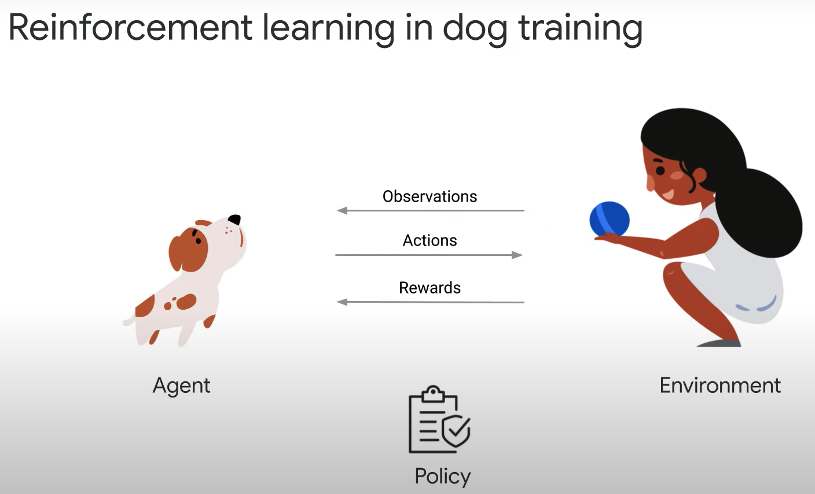
Source: cloudskillsboost.google

Slide 8
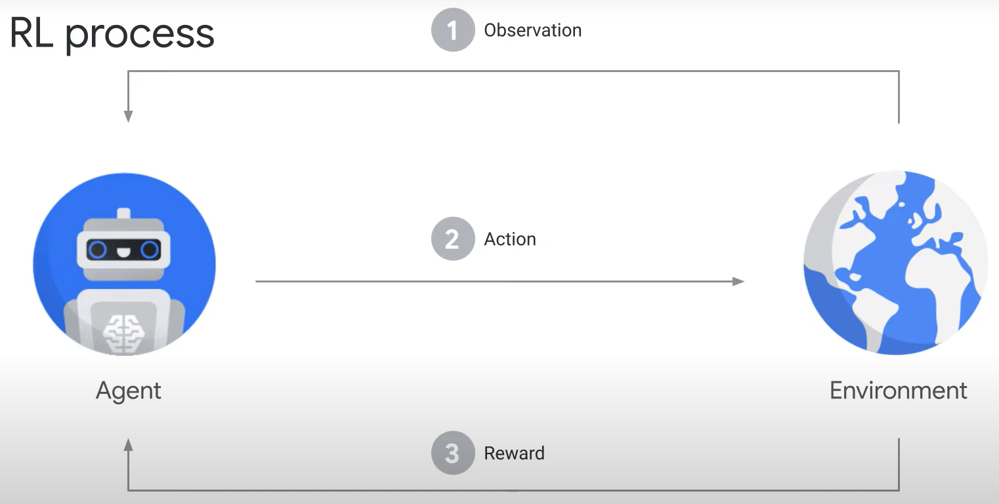
Source: cloudskillsboost.google

Slide 9
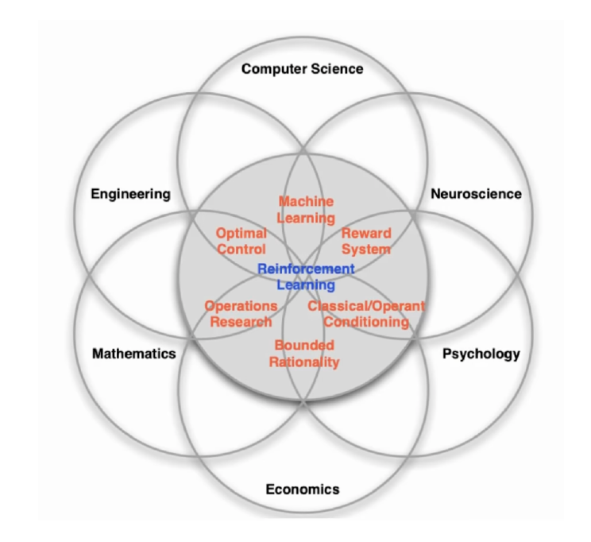
Interdisciplinary Nature of Reinforcement Learning
Source: ZHAW lecture slides on RL

Slide 10
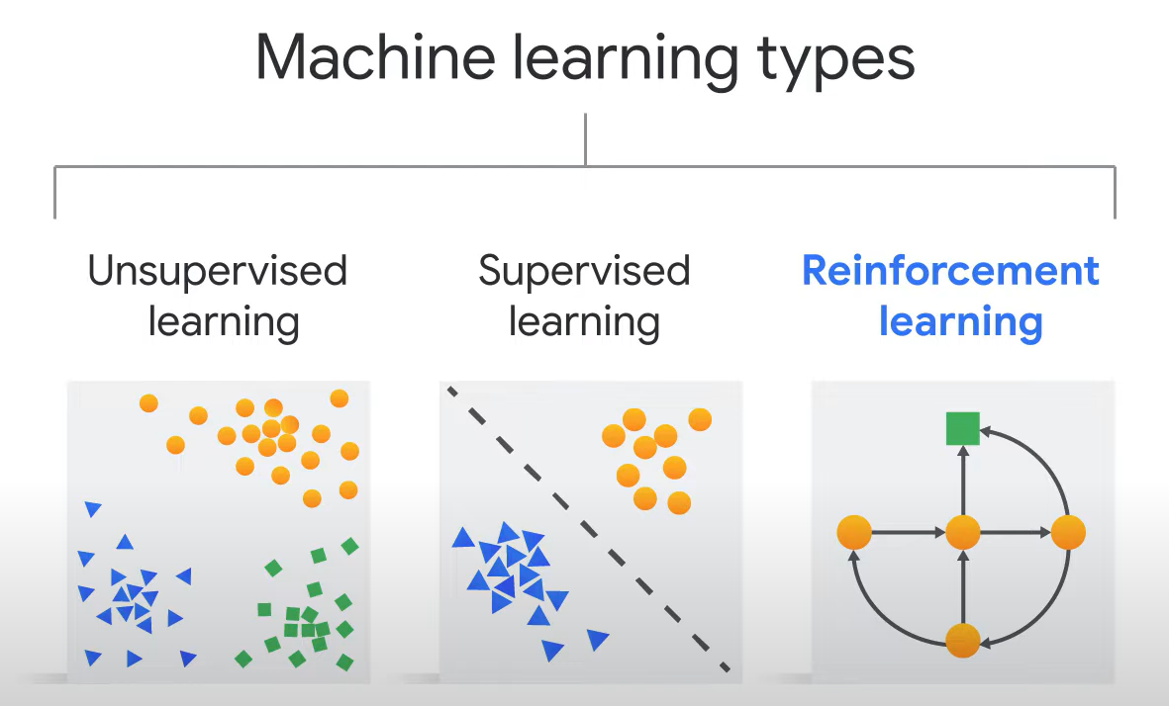
Reinforcement Learning is a Decision-making system trained to make optimal decisions.
Source: cloudskillsboost.google

Slide 11
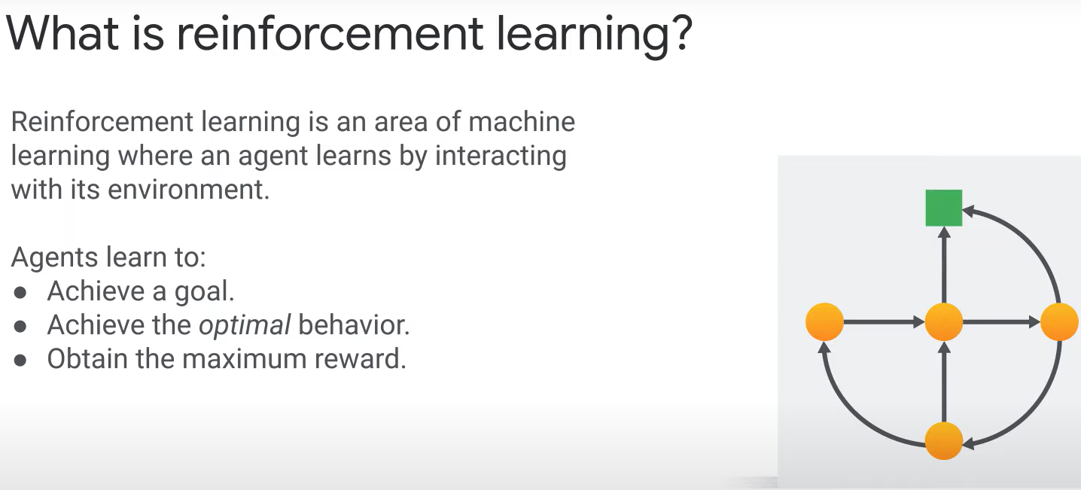
Reinforcement Learning:
operates with sparse and dynamic data
closer to the real-world problems
Source: cloudskillsboost.google

Slide 12
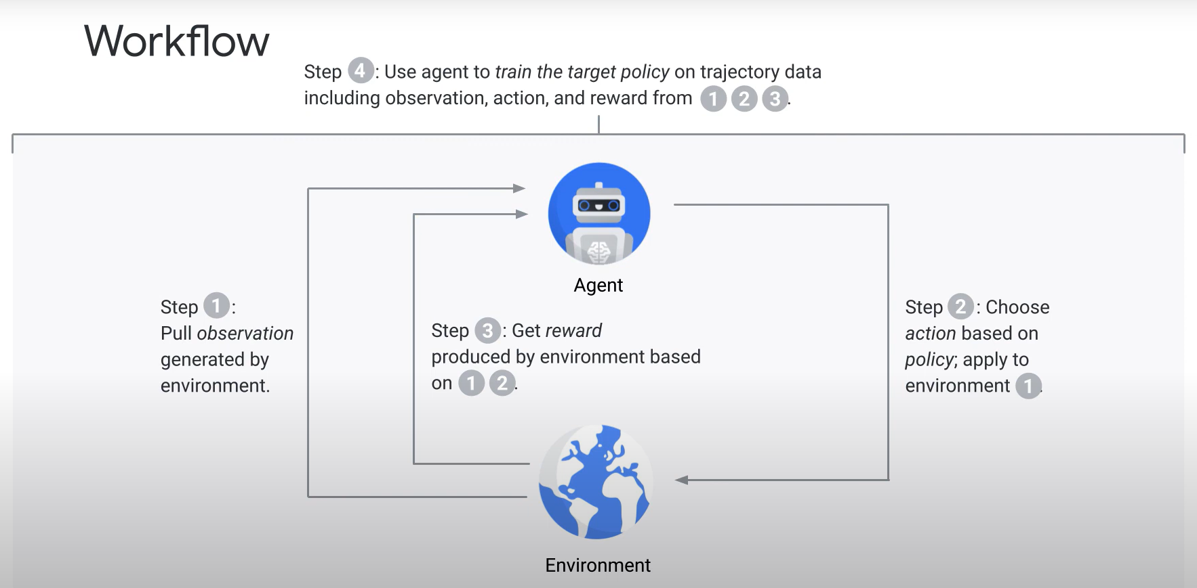
Source: cloudskillsboost.google

Slide 13
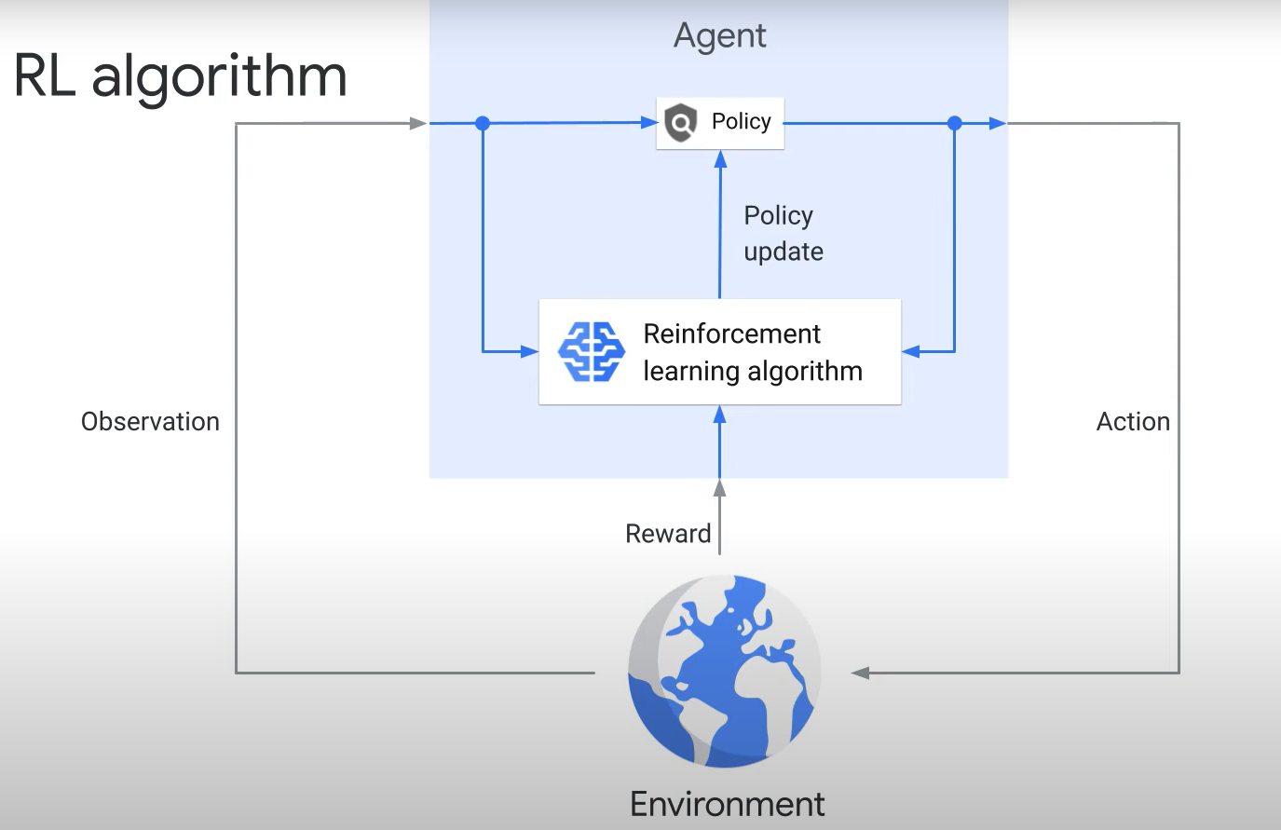
Source: cloudskillsboost.google

Slide 14
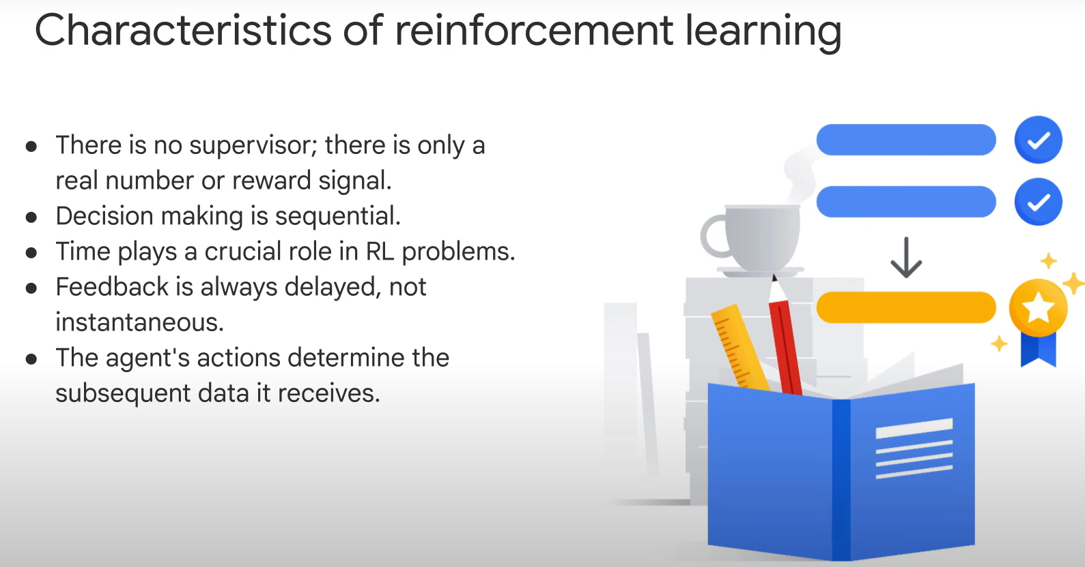
Source: cloudskillsboost.google

Slide 15
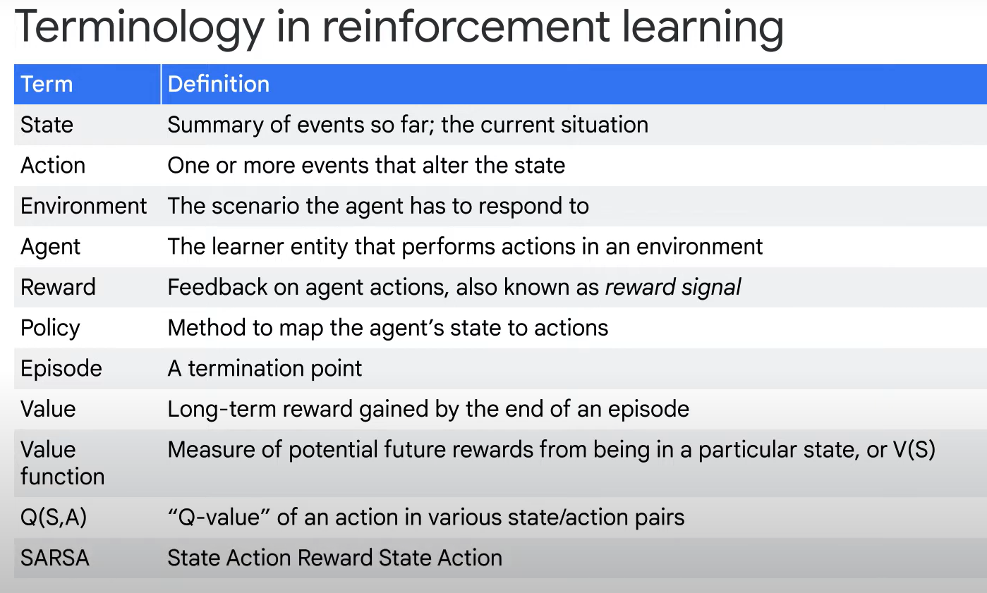
Source: cloudskillsboost.google

Slide 16
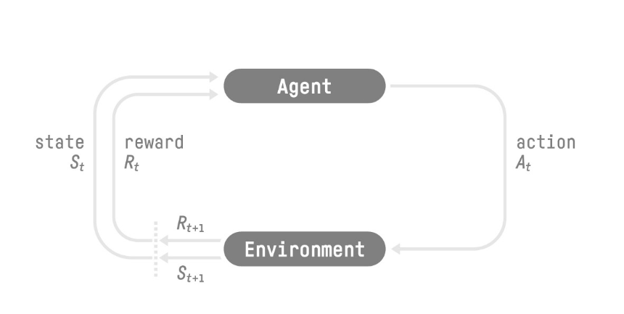
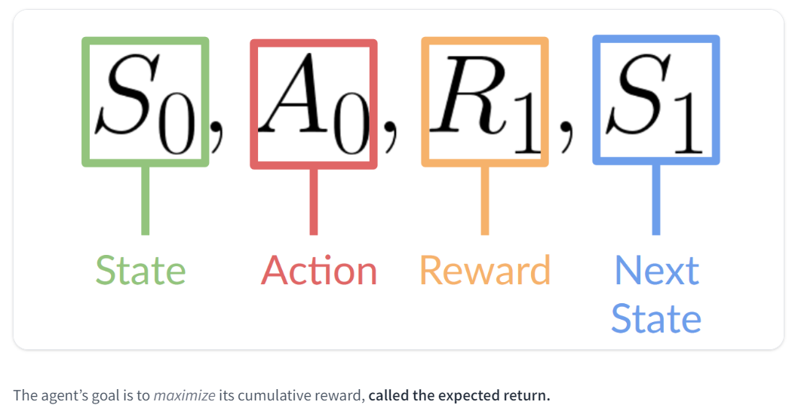
Source: https://huggingface.co/learn/deep-rl-course

Slide 17
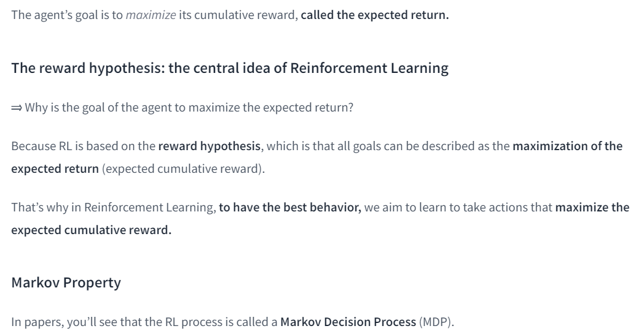
Source: https://huggingface.co/learn/deep-rl-course

Slide 18
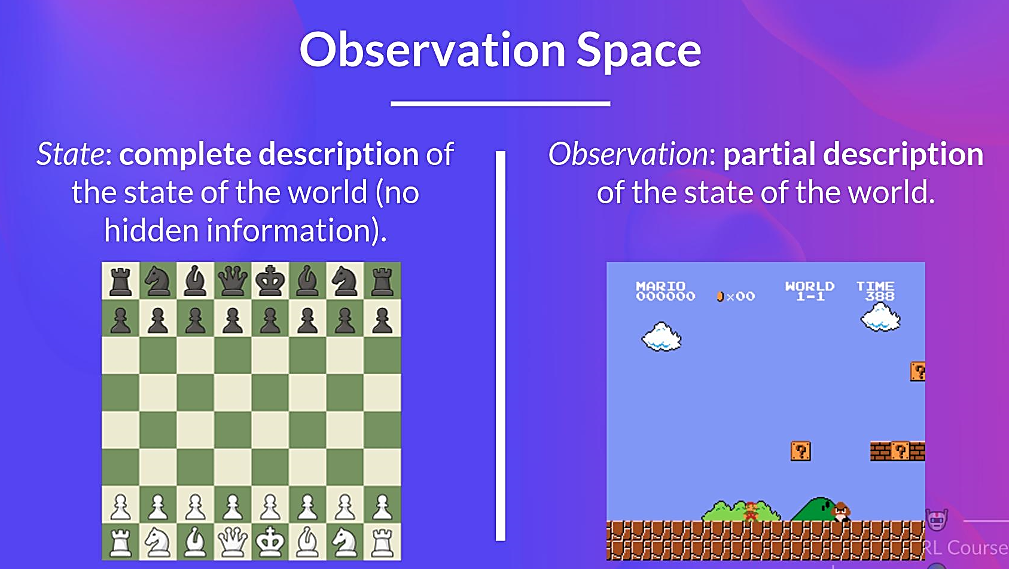
Source: https://huggingface.co/learn/deep-rl-course

Slide 19
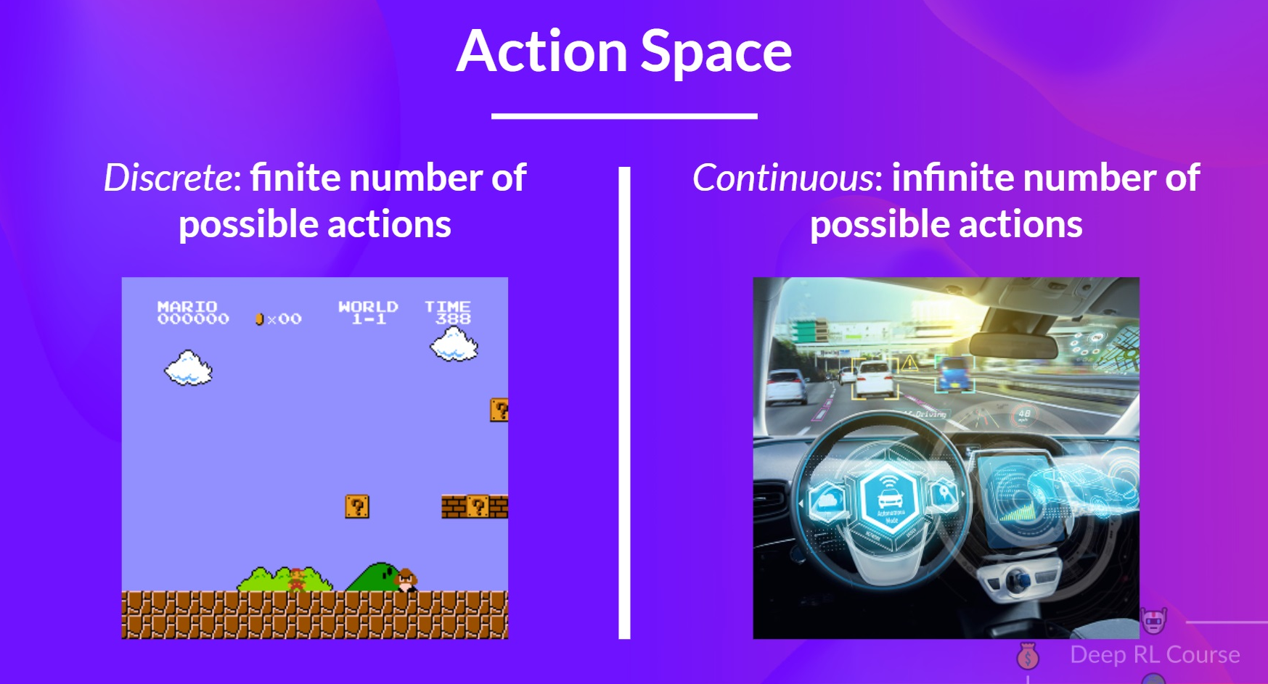
Source: https://huggingface.co/learn/deep-rl-course

Slide 20
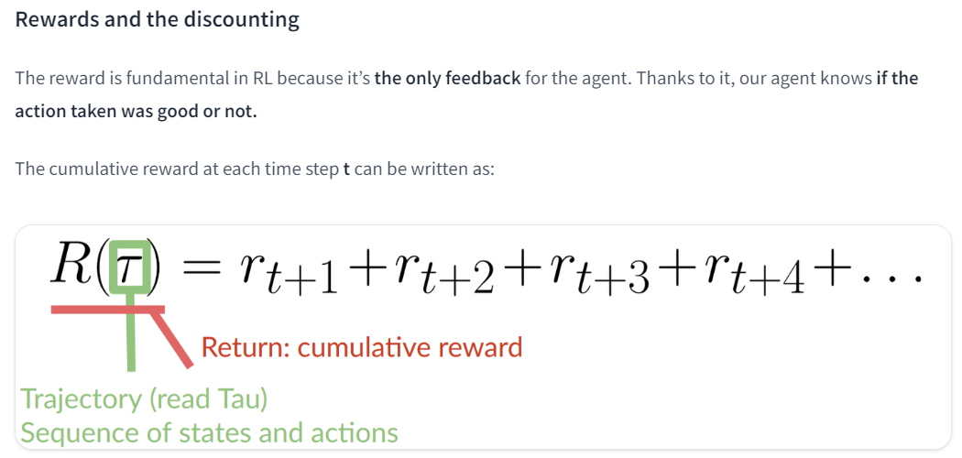
Source: https://huggingface.co/learn/deep-rl-course

Slide 21
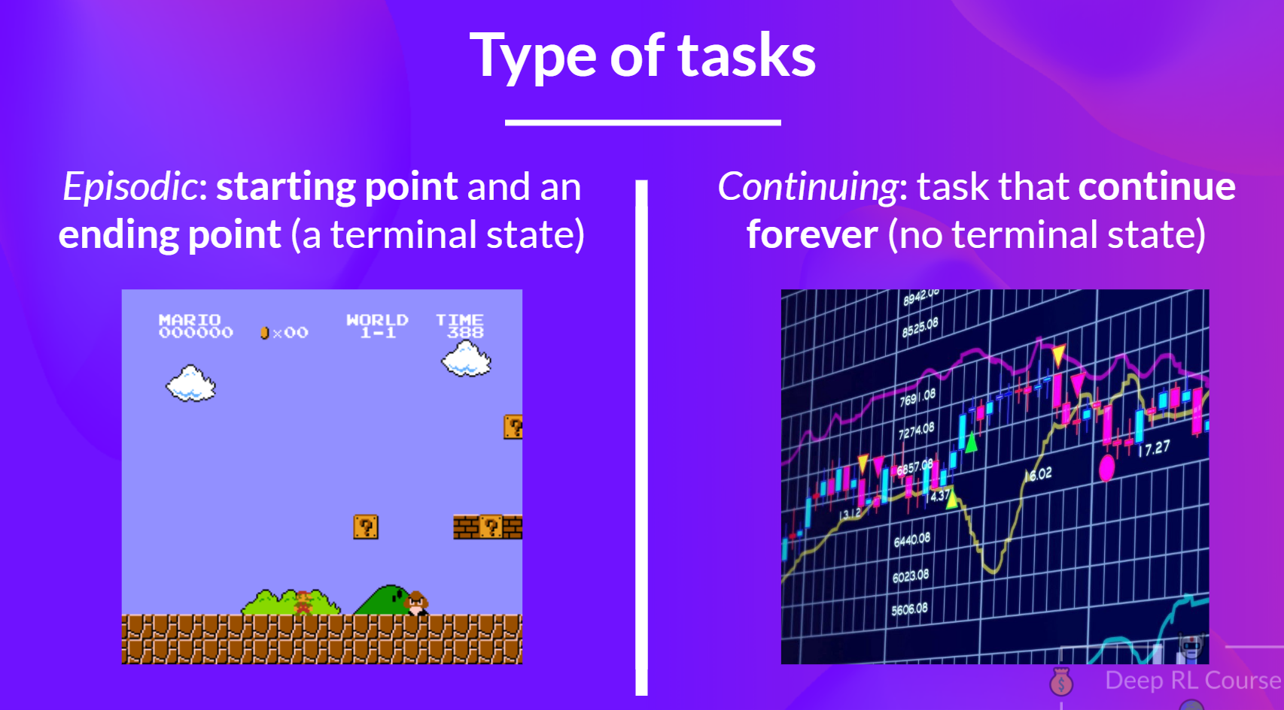
Source: https://huggingface.co/learn/deep-rl-course

Slide 22
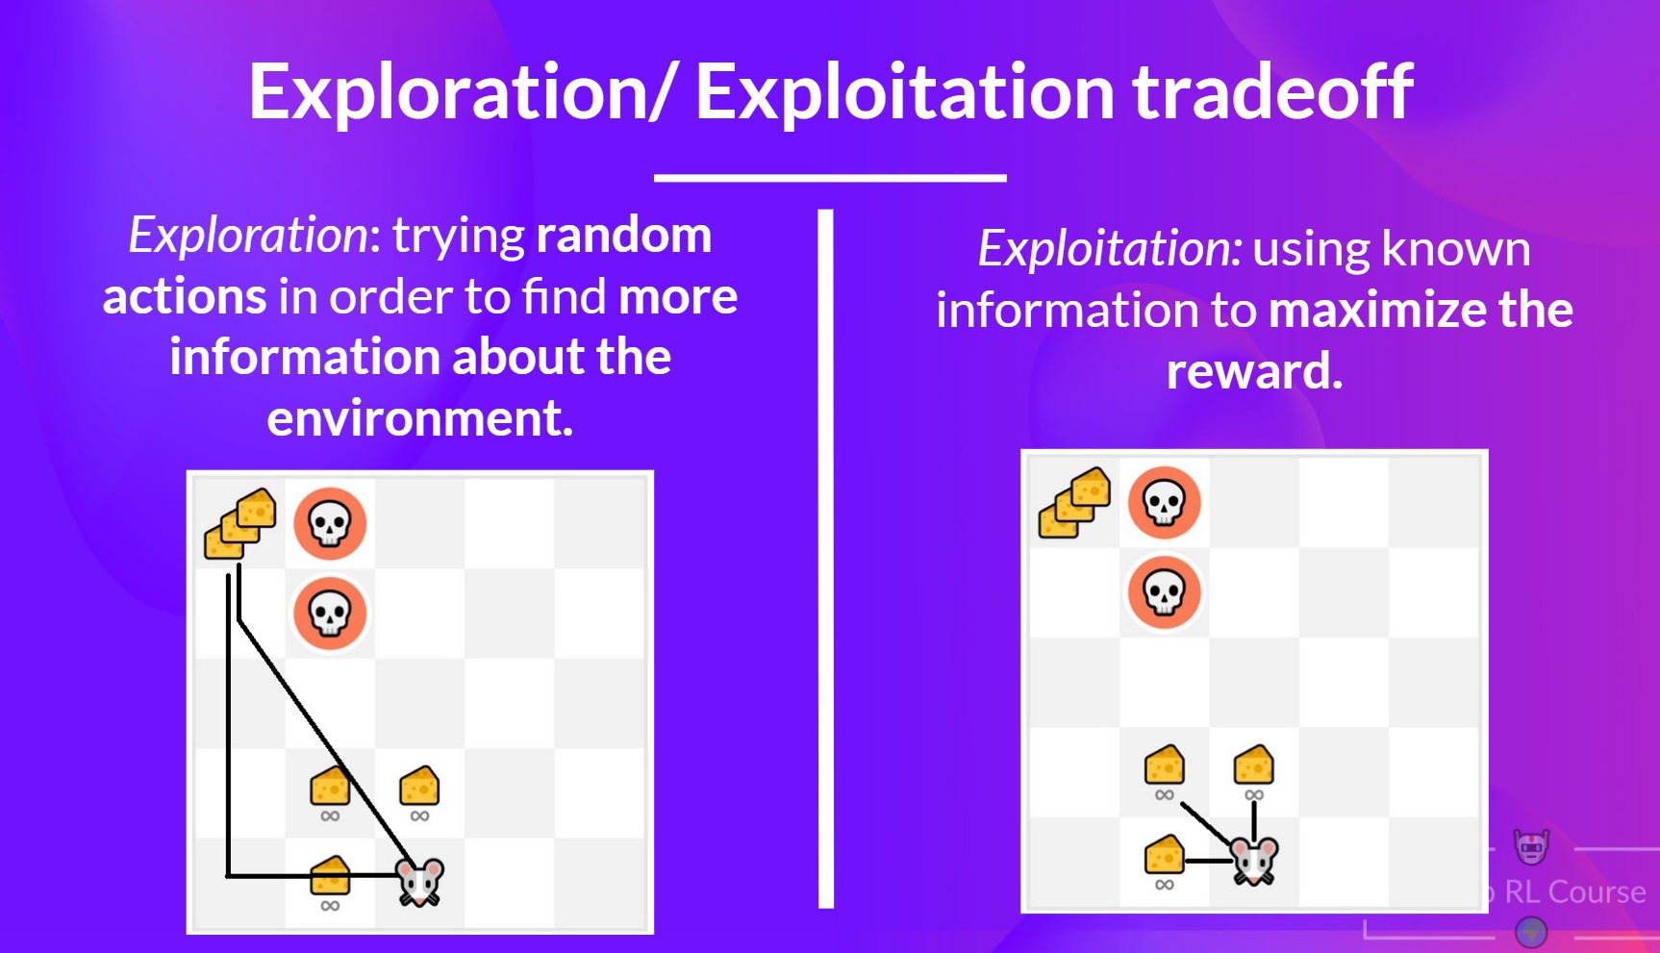
Source: https://huggingface.co/learn/deep-rl-course

Slide 23
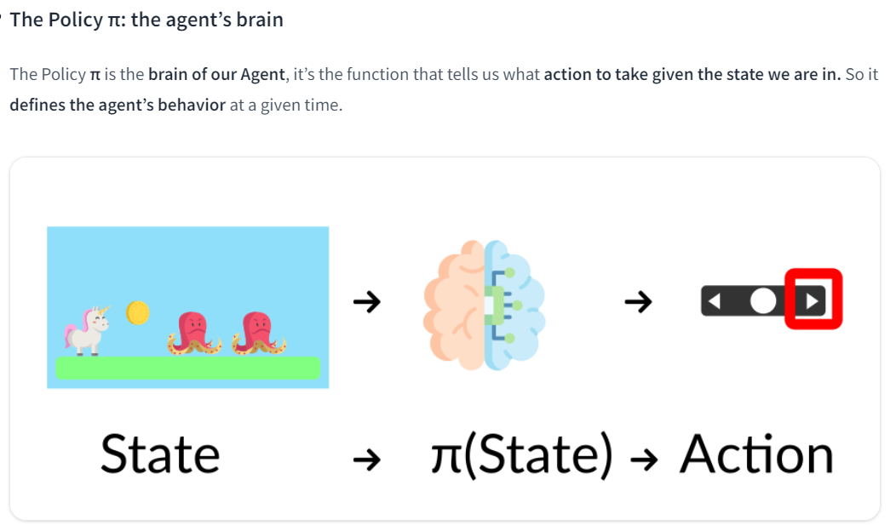
Source: https://huggingface.co/learn/deep-rl-course

Slide 24
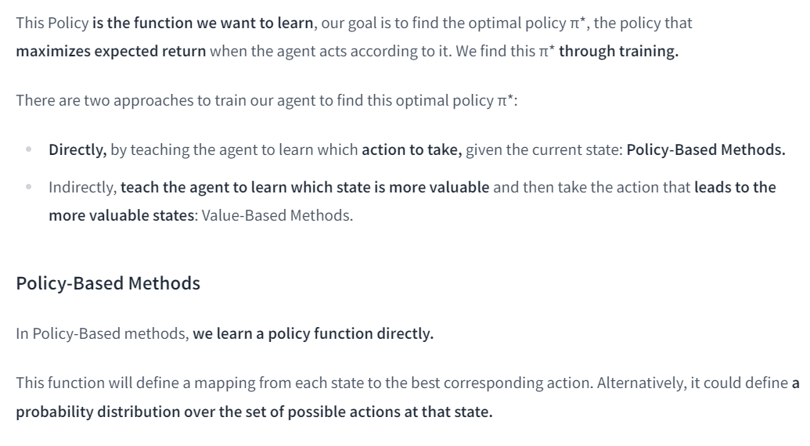
Source: https://huggingface.co/learn/deep-rl-course

Slide 25
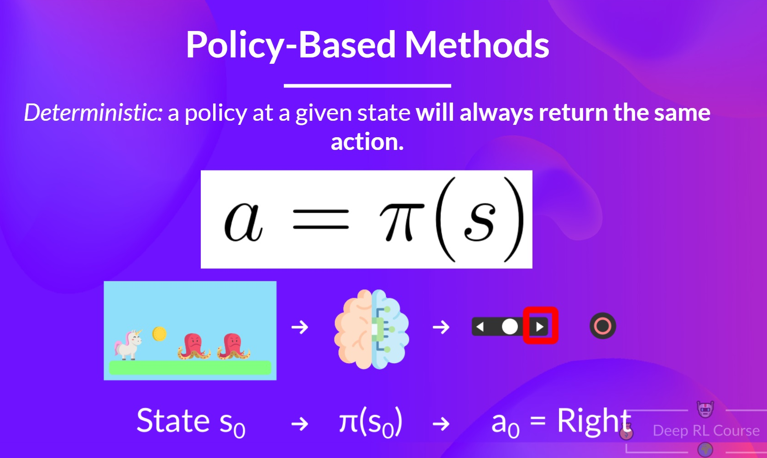
Source: https://huggingface.co/learn/deep-rl-course

Slide 26
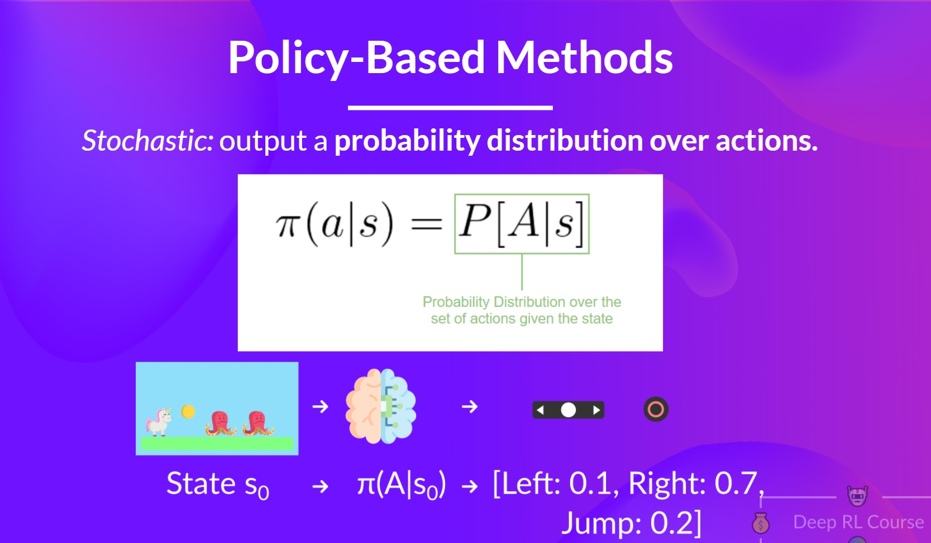
Source: https://huggingface.co/learn/deep-rl-course

Slide 27
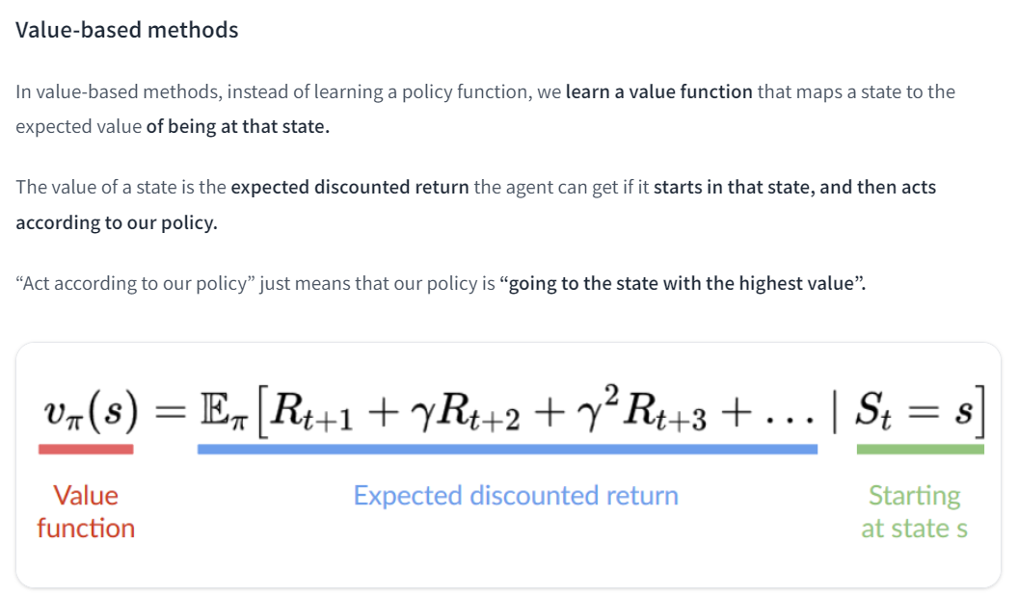
Source: https://huggingface.co/learn/deep-rl-course

Slide 28
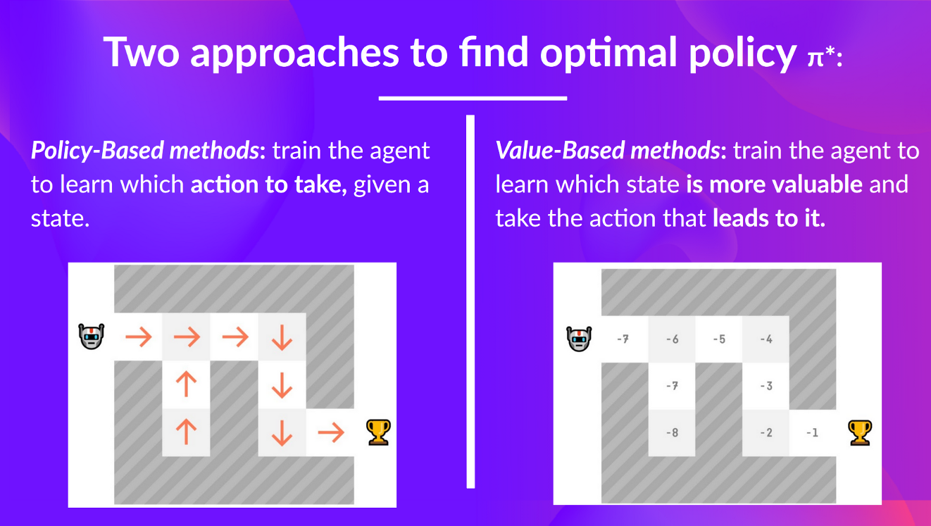
Source: https://huggingface.co/learn/deep-rl-course

Slide 29
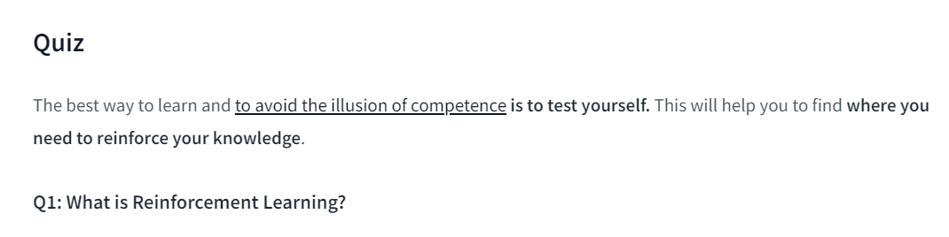
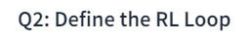
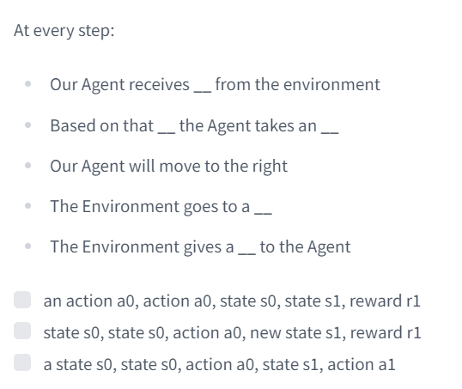
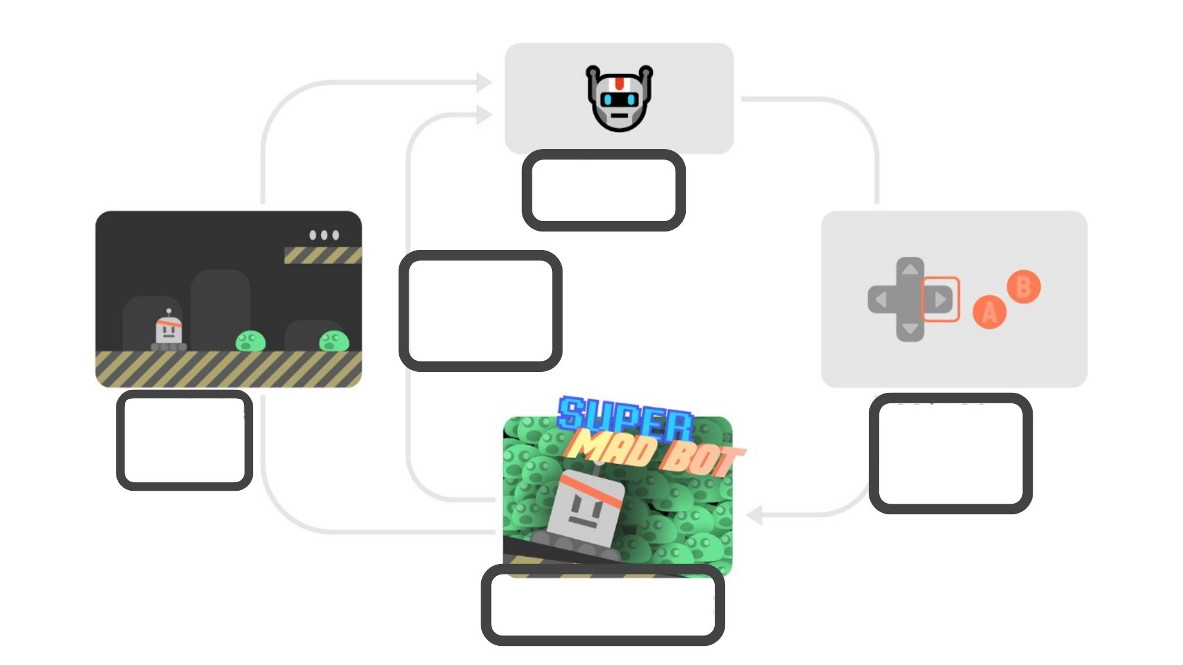
Source: https://huggingface.co/learn/deep-rl-course

Slide 30
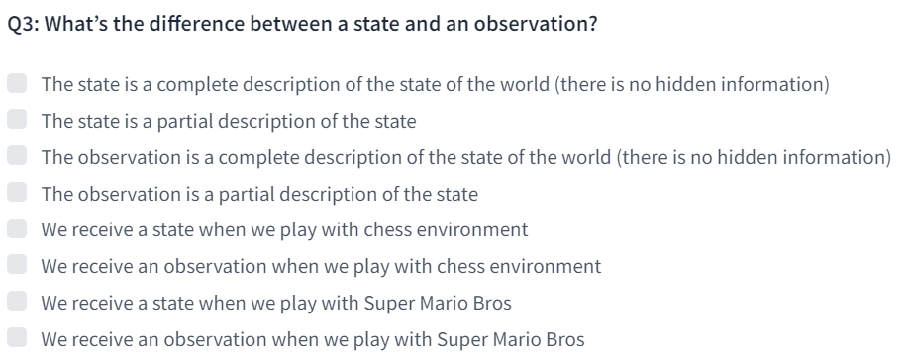
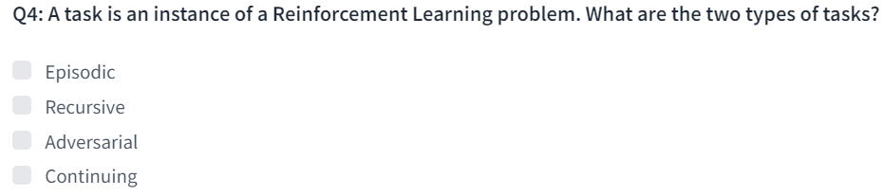
Source: https://huggingface.co/learn/deep-rl-course

Slide 31
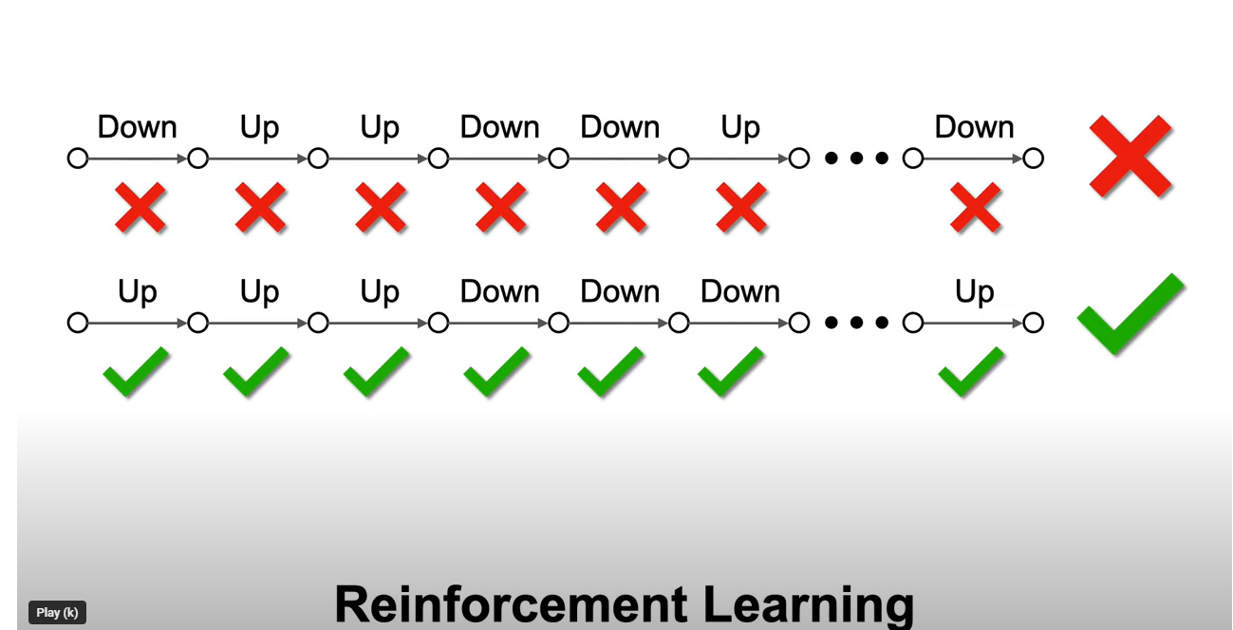
https://www.youtube.com/watch?v=vXtfdGphr3c

Slide 32
Reinforcement Learning
Applications
Dr. Aygul Zagidullina

Slide 33
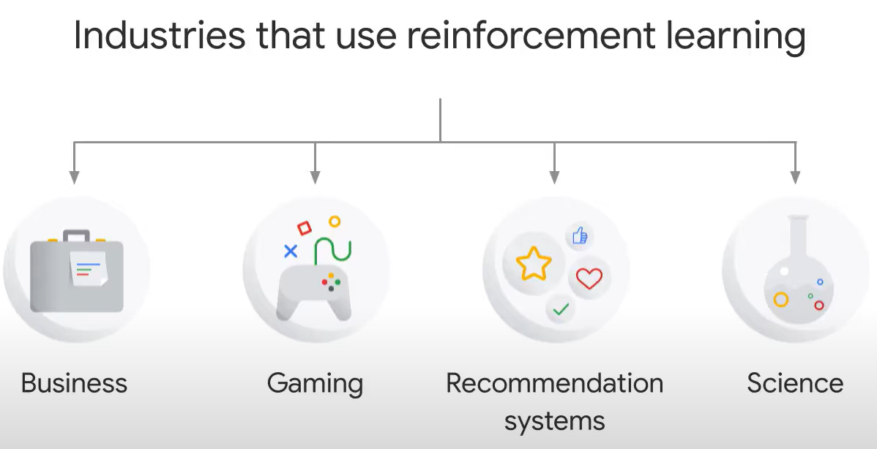
Source: cloudskillsboost.google

Slide 34
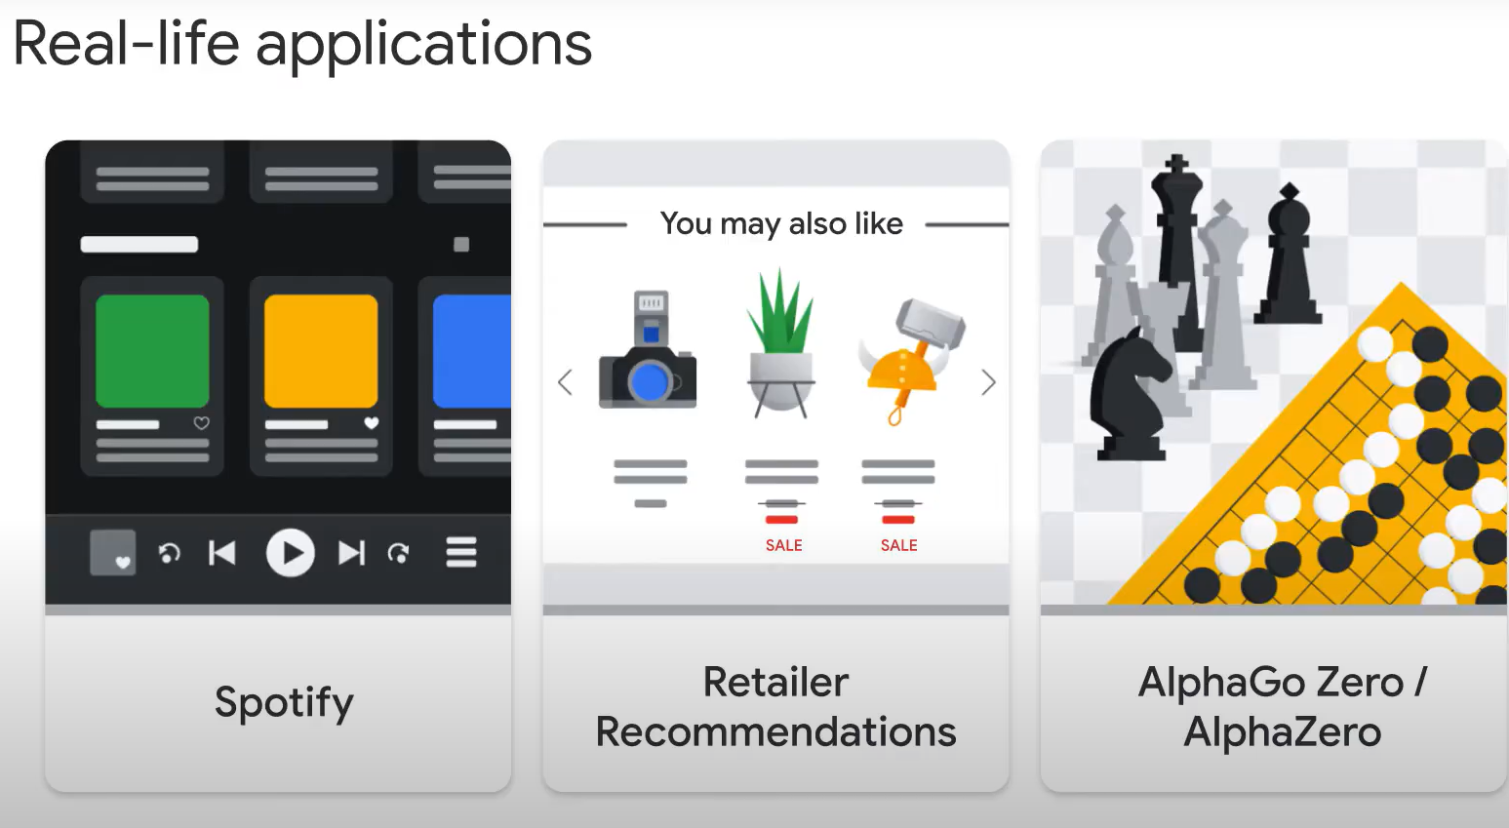
Source: cloudskillsboost.google

Slide 35
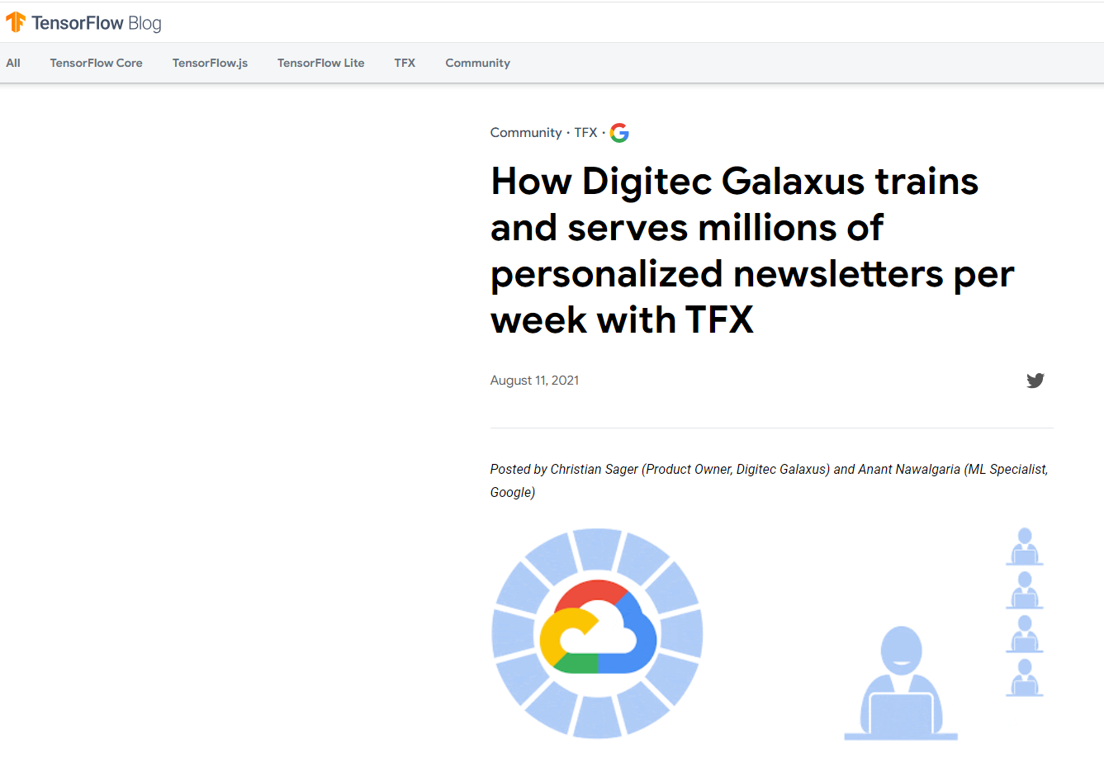
https://blog.tensorflow.org/2021/08/how-digitec-galaxus-trains-and-serves-millions-of-personalized-newsletters-per-week-with-TFX.html

Slide 36
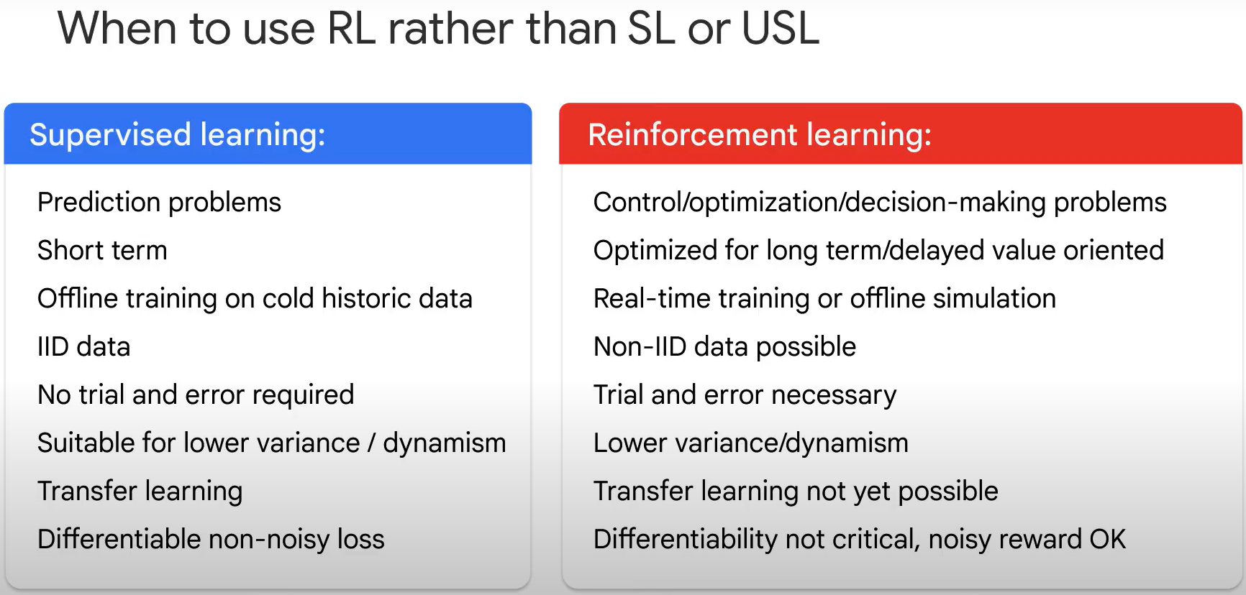
Source: cloudskillsboost.google

Slide 37
Reinforcement Learning
Model-based and Model-free Approaches
Dr. Aygul Zagidullina

Slide 38
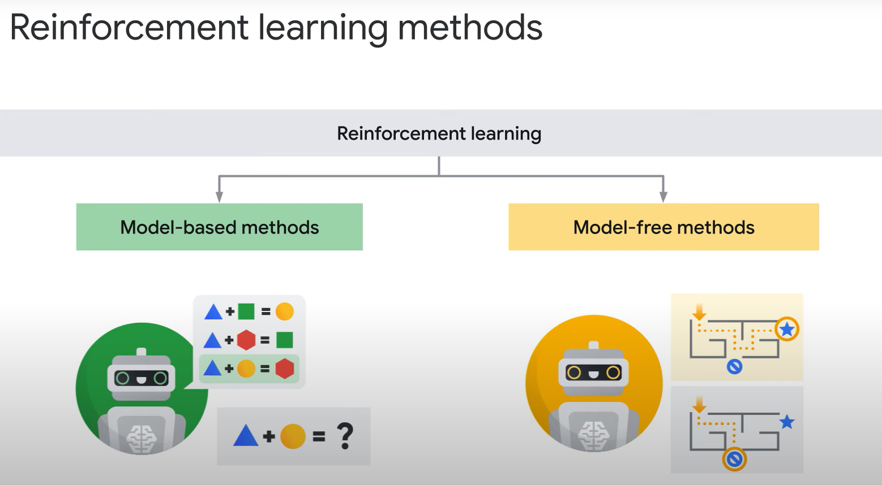
Source: cloudskillsboost.google

Slide 39
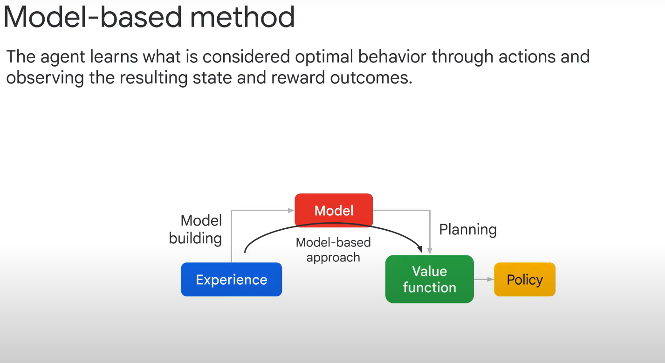
Source: cloudskillsboost.google

Slide 40
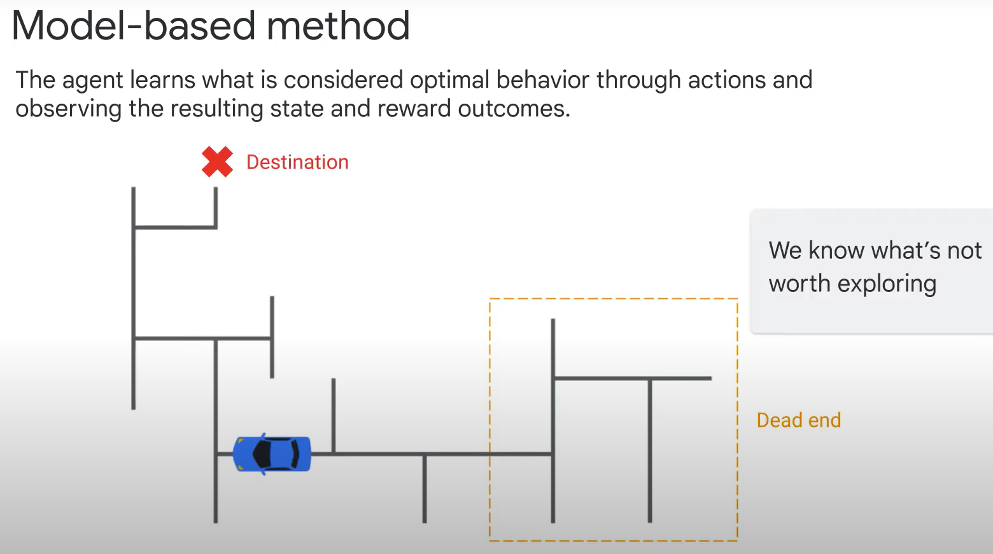
Source: cloudskillsboost.google

Slide 41
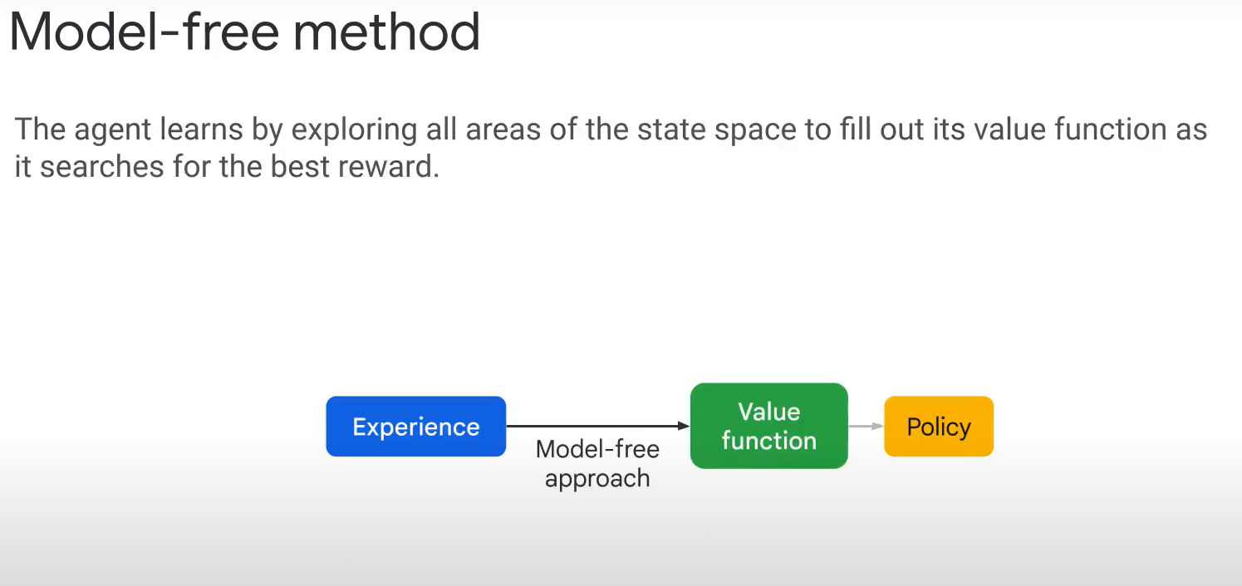
Source: cloudskillsboost.google

Slide 42
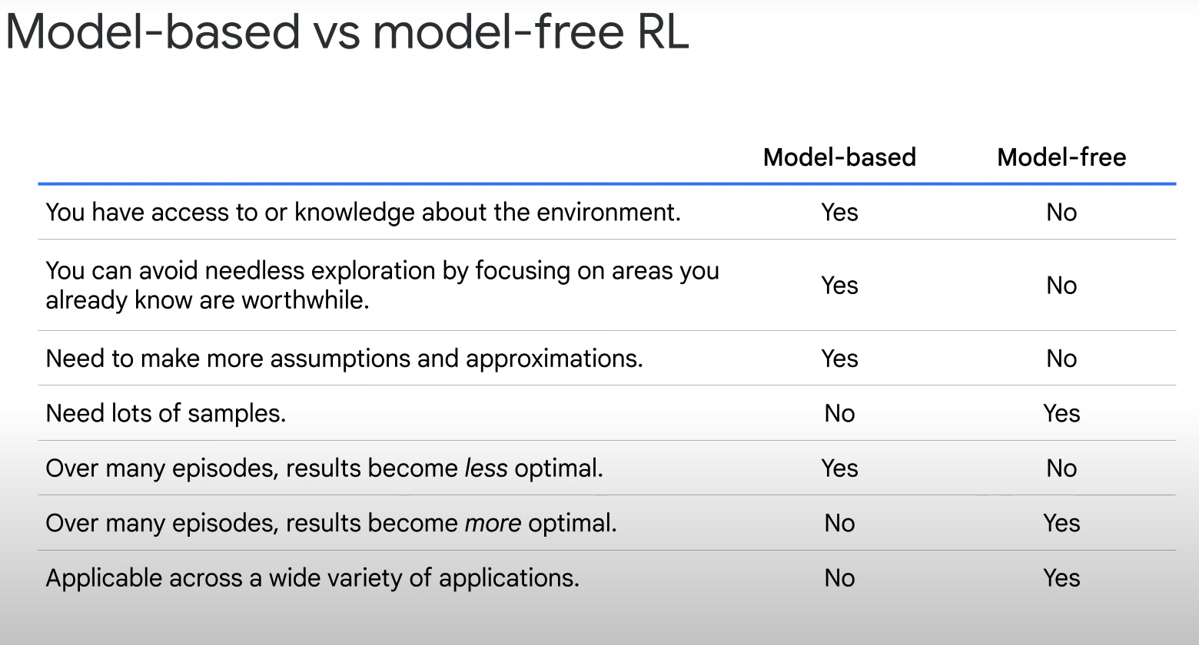
Source: cloudskillsboost.google

Slide 43
Reinforcement Learning
Policy-based Approaches
Dr. Aygul Zagidullina

Slide 44
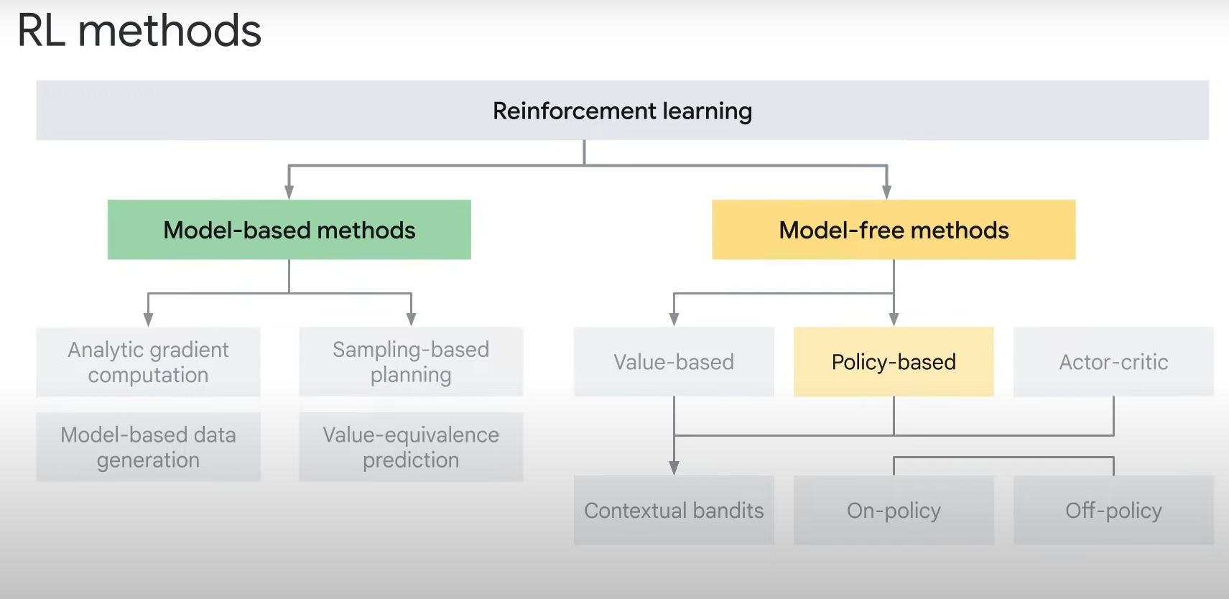
Source: cloudskillsboost.google

Slide 45
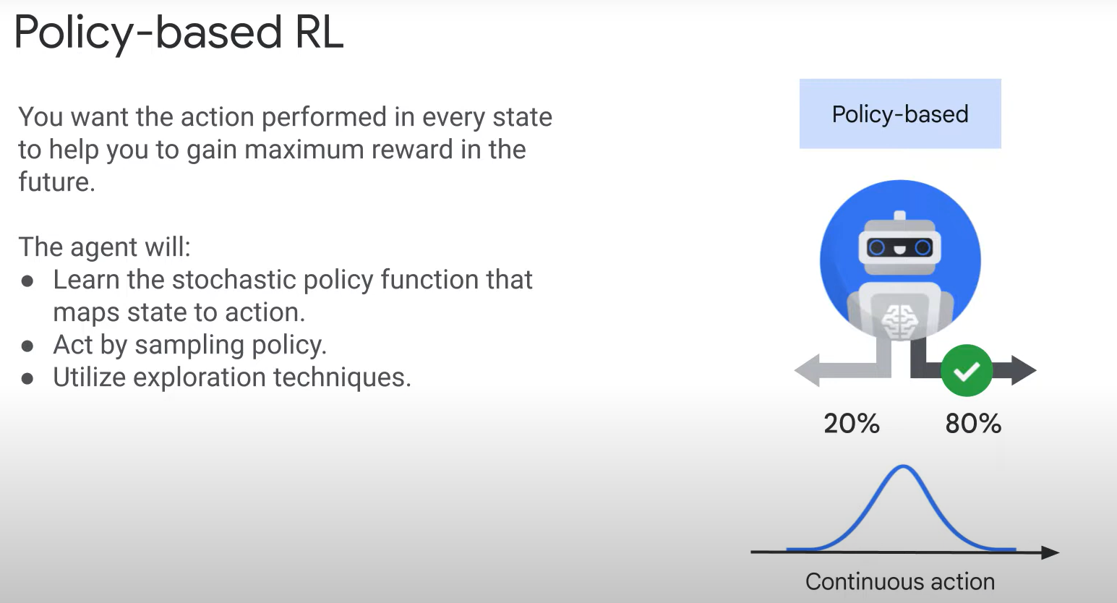
Source: cloudskillsboost.google

Slide 46
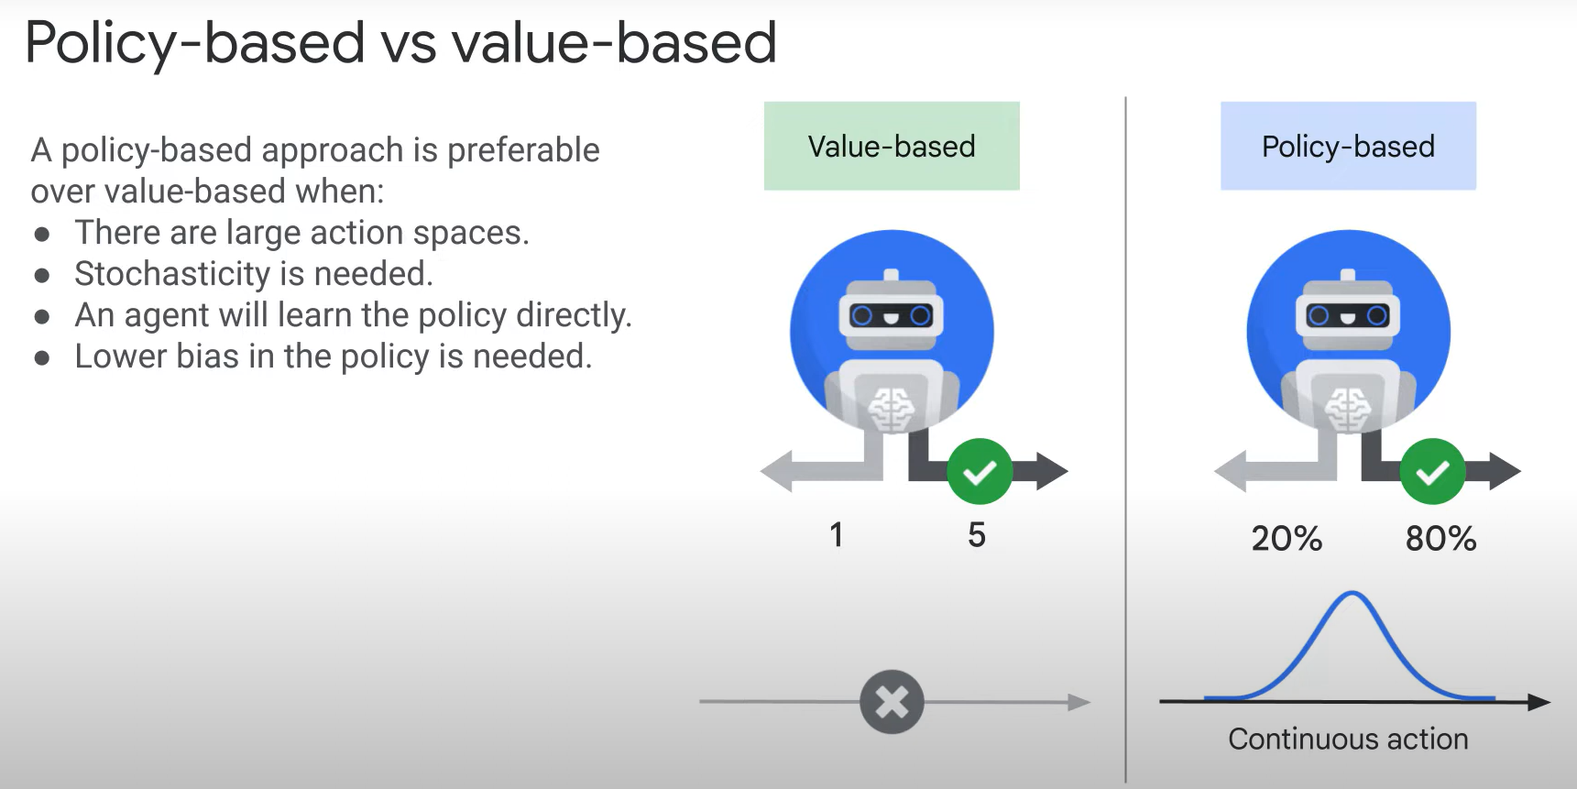
Source: cloudskillsboost.google

Slide 47
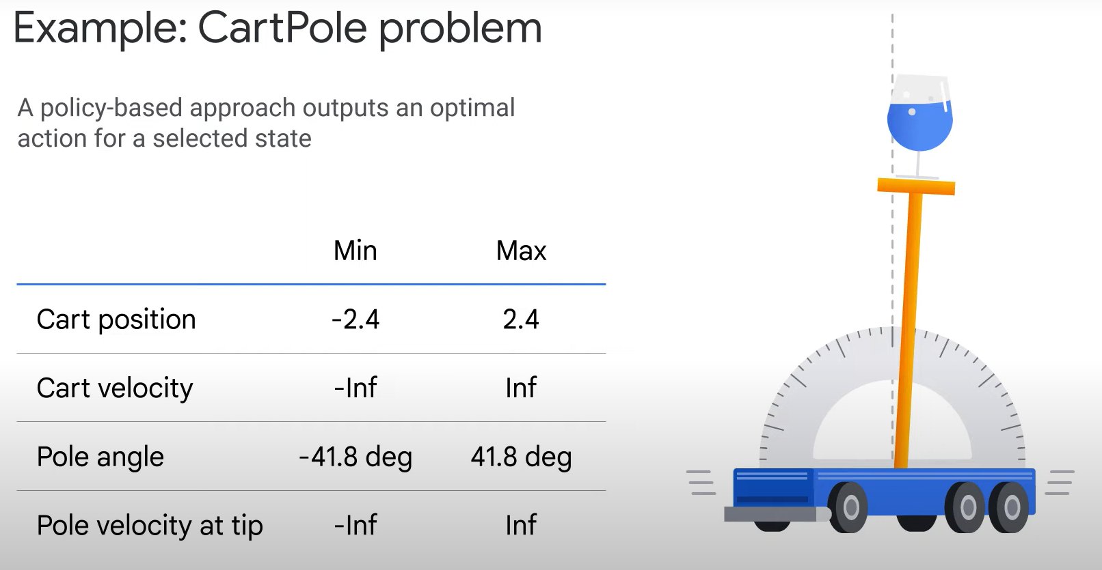
Source: cloudskillsboost.google

Slide 48
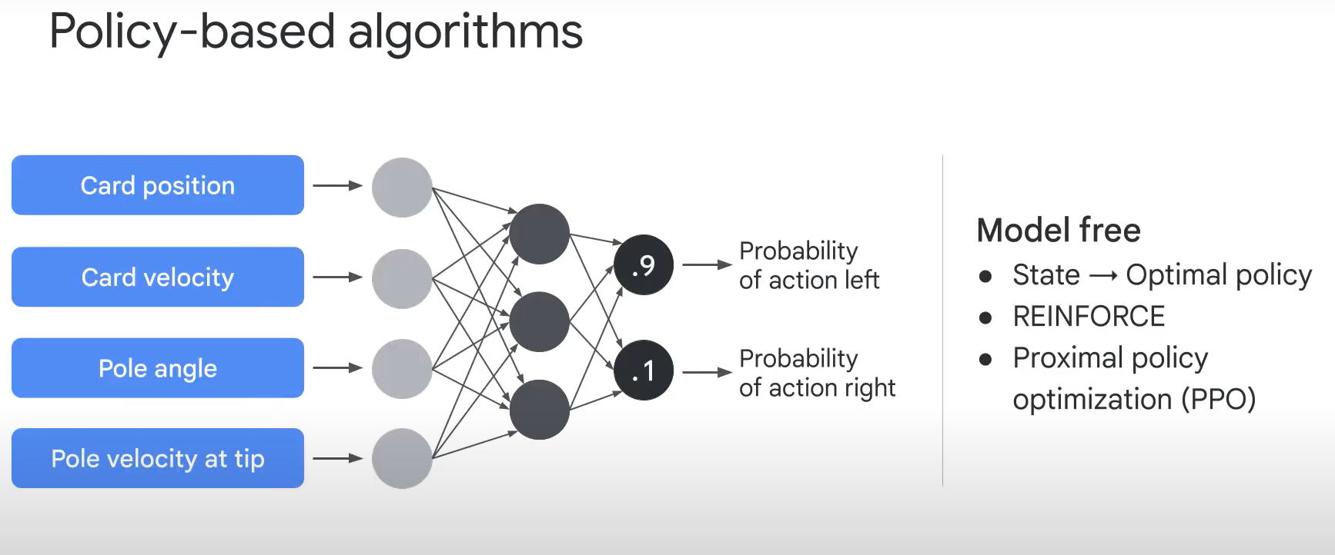
Source: cloudskillsboost.google

Slide 49
Reinforcement Learning
Value-based Approaches
Dr. Aygul Zagidullina

Slide 50
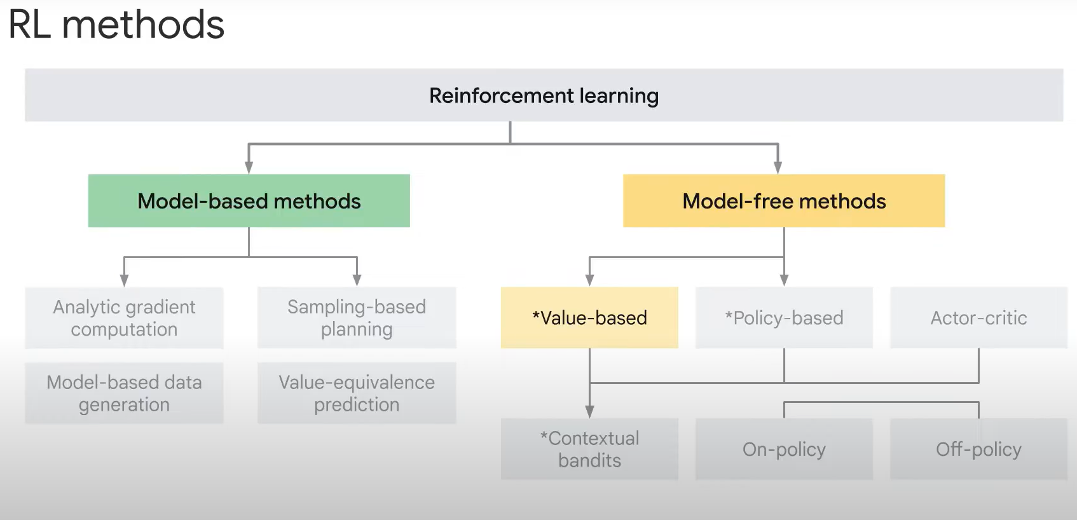
Source: cloudskillsboost.google

Slide 51

Source: https://huggingface.co/learn/deep-rl-course

Slide 52

Source: https://huggingface.co/learn/deep-rl-course

Slide 53

Source: https://huggingface.co/learn/deep-rl-course

Slide 54

Source: https://huggingface.co/learn/deep-rl-course

Slide 55



Slide 56

Source: cloudskillsboost.google

Slide 57

Source: cloudskillsboost.google

Slide 58

Source: cloudskillsboost.google

Slide 59

Source: https://huggingface.co/learn/deep-rl-course

Slide 60

Source: https://huggingface.co/learn/deep-rl-course

Slide 61

Source: https://huggingface.co/learn/deep-rl-course

Slide 62

Source: cloudskillsboost.google

Slide 63

Source: cloudskillsboost.google

Slide 64

Source: cloudskillsboost.google

Slide 65

Source: cloudskillsboost.google

Slide 66

Source: cloudskillsboost.google

Slide 67
Source: https://huggingface.co/learn/deep-rl-course

Slide 68

Source: https://huggingface.co/learn/deep-rl-course

Slide 69

Source: https://huggingface.co/learn/deep-rl-course

Slide 70

Source: cloudskillsboost.google

Slide 71

Source: cloudskillsboost.google

Slide 72

https://www.youtube.com/watch?v=2nKD6zFQ8xI&list=PLQY2H8rRoyvxWE6bWx8XiMvyZFgg_25Q_&index=2

Slide 73
Reinforcement Learning
Contextual Bandits
Dr. Aygul Zagidullina

Slide 74

Source: cloudskillsboost.google

Slide 75

Source: cloudskillsboost.google

Slide 76

Source: cloudskillsboost.google

Slide 77

Source: cloudskillsboost.google

Slide 78
Regret metric
This metric measures the difference between the reward obtained by the chosen action and the reward that would have been obtained by taking the best possible action.
Mathematically, regret at time t is given by:
Regret(t) = Optimal Reward(t)−Actual Reward(t)
Regret, when accumulated over time, provides insight into how much we’ve “lost” by not always choosing the best action. It is preferred over cumulative reward because it provides a clearer indication of the algorithm’s performance relative to the optimal scenario.
Ideally, a regret value close to 0 indicates proximity to optimal decision-making.

Slide 79

Source: cloudskillsboost.google

Slide 80

Source: cloudskillsboost.google

Slide 81


Slide 82

https://www.youtube.com/watch?v=g0yDlAbi6Pc

Slide 83
Code Discussion

